Slide 1






CPUE standardization offshore fleet - SPRFMO
N.T. Hintzen
May 2026
www.pelagicfish.eu

Slide 2
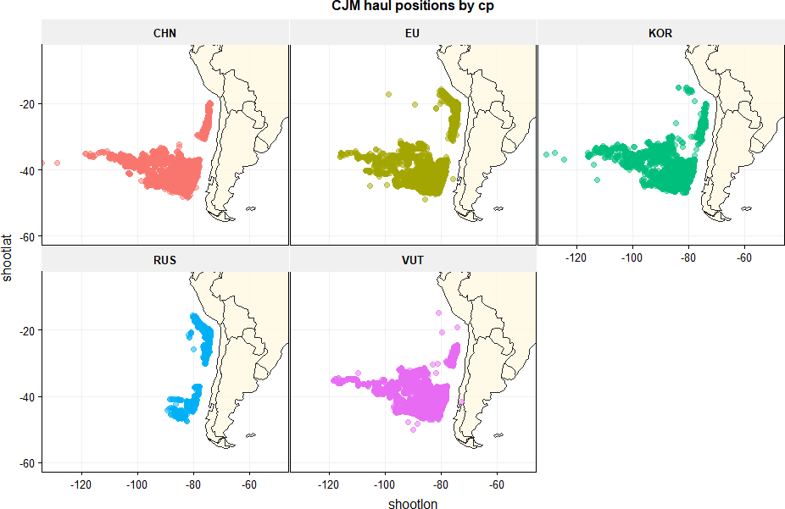
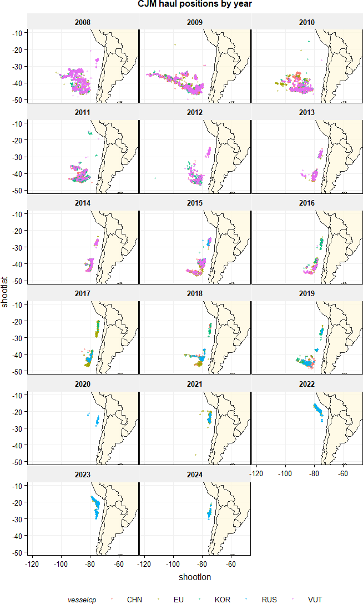
Figure 2: Jack Mackerel Haul Positions by Year — Five Contracting Parties
Haul positions by contracting party (all years)
Figure 2: Haul positions by year (colours = contracting party)
www.pelagicfish.eu

Slide 3
Tables 1 & 2: Fleet Participation and Total Catch by Contracting Party
Table 1: Number of vessels
Table 2: Total catch (tonnes)
year | CHN | EU | KOR | RUS | VUT | all
2007 | 0 | 0 | 2 | 0 | 0 | 2
2008 | 0 | 5 | 2 | 0 | 4 | 11
2009 | 13 | 6 | 2 | 0 | 4 | 25
2010 | 9 | 6 | 2 | 0 | 4 | 21
2011 | 6 | 2 | 2 | 0 | 2 | 12
2012 | 3 | 0 | 2 | 0 | 2 | 7
2013 | 2 | 1 | 1 | 0 | 2 | 6
2014 | 3 | 2 | 1 | 0 | 2 | 8
2015 | 6 | 2 | 2 | 1 | 2 | 13
2016 | 2 | 2 | 2 | 0 | 1 | 7
2017 | 2 | 2 | 1 | 1 | 0 | 6
2018 | 2 | 1 | 2 | 1 | 0 | 6
2019 | 2 | 1 | 2 | 1 | 0 | 6
2020 | 0 | 0 | 0 | 1 | 0 | 1
2021 | 0 | 3 | 0 | 1 | 0 | 4
2022 | 0 | 2 | 0 | 2 | 0 | 4
2023 | 0 | 3 | 0 | 3 | 0 | 6
2024 | 0 | 2 | 1 | 2 | 0 | 5
year | CHN | EU | KOR | RUS | VUT | all
2007 | 0 | 0 | 10,524 | 0 | 0 | 10,524
2008 | 0 | 66,260 | 12,377 | 0 | 101,955 | 180,592
2009 | 117,963 | 80,391 | 13,759 | 0 | 80,166 | 292,279
2010 | 63,579 | 31,258 | 8,183 | 0 | 45,934 | 148,954
2011 | 32,862 | 1,185 | 9,253 | 0 | 7,628 | 50,928
2012 | 13,012 | 0 | 5,492 | 0 | 16,463 | 34,966
2013 | 8,329 | 10,012 | 5,267 | 0 | 15,526 | 39,133
2014 | 21,155 | 20,510 | 4,078 | 0 | 15,473 | 61,215
2015 | 29,180 | 28,007 | 5,749 | 2,524 | 21,224 | 86,683
2016 | 20,208 | 11,470 | 6,430 | 0 | 7,385 | 45,492
2017 | 16,586 | 27,652 | 1,235 | 3,188 | 0 | 48,662
2018 | 24,366 | 9,620 | 3,717 | 4,686 | 0 | 42,389
2019 | 22,706 | 11,789 | 7,444 | 9,412 | 0 | 51,352
2020 | 0 | 0 | 0 | 5,245 | 0 | 5,245
2021 | 0 | 42,990 | 0 | 11,839 | 0 | 54,830
2022 | 0 | 44,425 | 0 | 29,443 | 0 | 73,869
2023 | 0 | 36,997 | 0 | 43,938 | 0 | 80,935
2024 | 0 | 17,749 | 1,798 | 12,138 | 0 | 31,685
(all) | 369,947 | 440,315 | 95,304 | 122,414 | 311,753 | 1,339,732
www.pelagicfish.eu

Slide 4
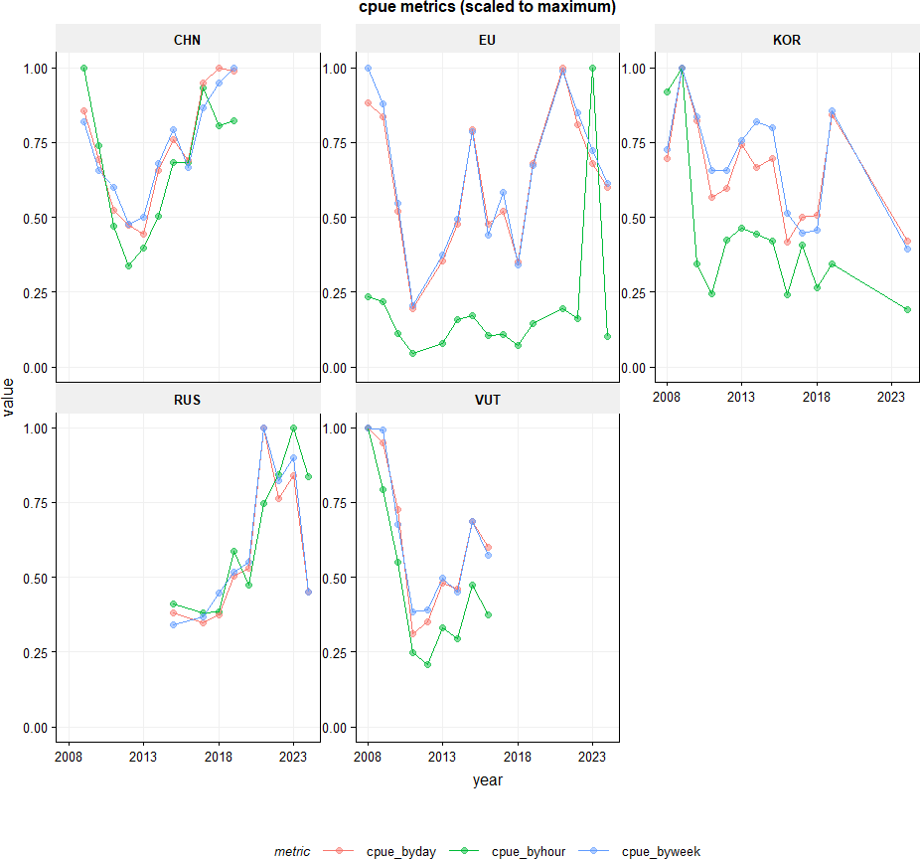
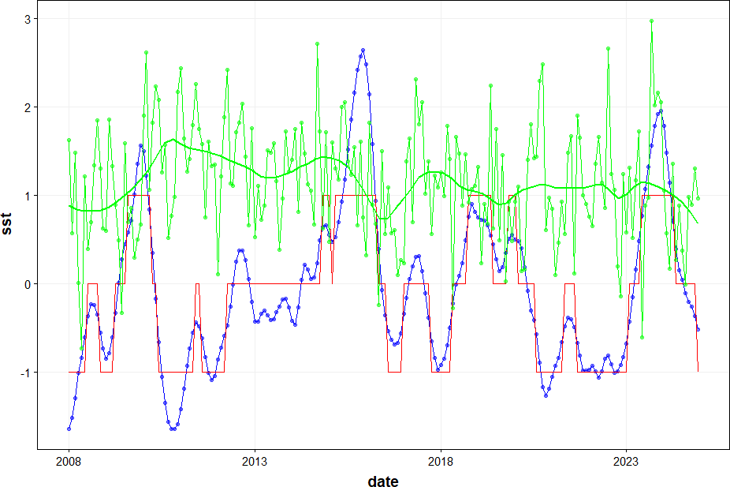
Figures 5 & 7: Nominal CPUE Metrics and Climate Context
Figure 5: CPUE by hour, day and week scaled to max — by day and week track closely
Figure 7: El Niño SST anomaly (blue), ELE indicator (red), Humboldt Current Index (green)
www.pelagicfish.eu

Slide 5
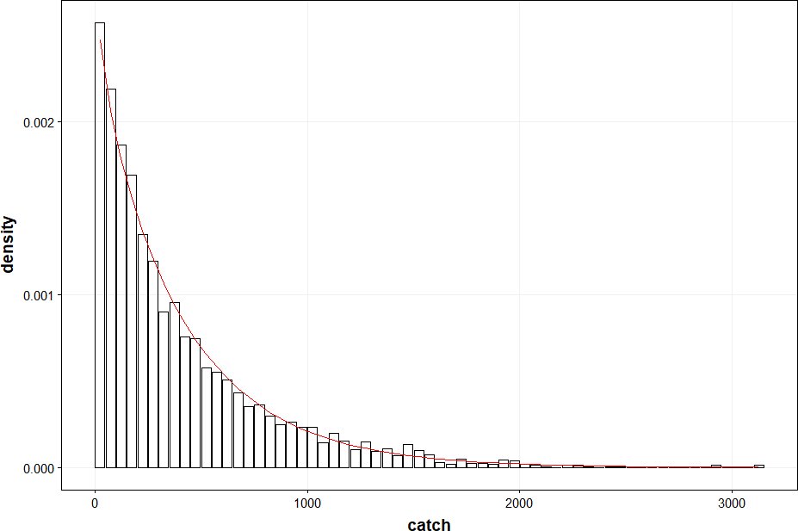
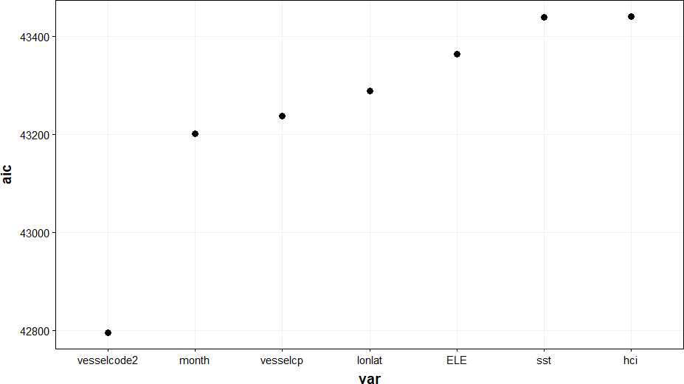
Figures 8 & 9: Negative Binomial Distribution Fit and AIC — Step 1 (Vessel Effect)
Figure 8: Weekly catch fits negative binomial distribution (θ ≈ 2.1)
Figure 9: AIC by 1st linear effect — vesselcode gives lowest AIC (best fit)
www.pelagicfish.eu

Slide 6
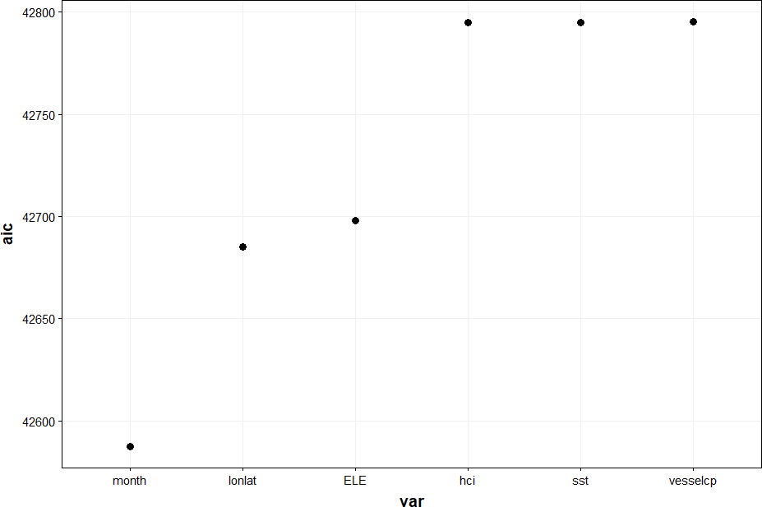
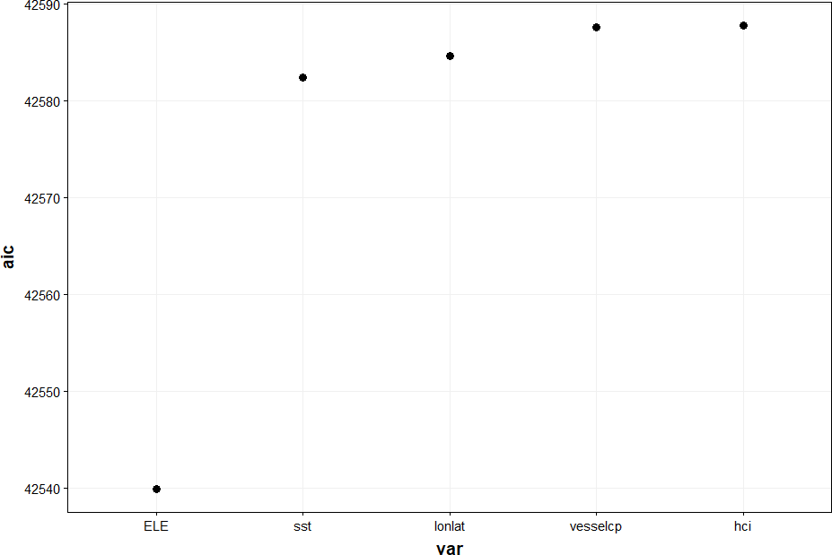
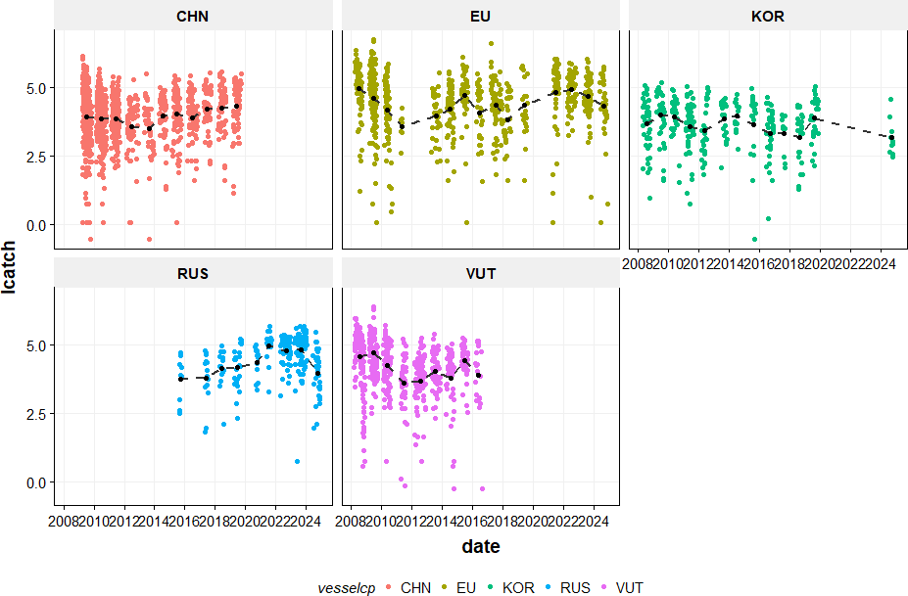
Figures 10–11: Stepwise AIC — Step 2 (Month) and Step 3 (El Niño ELE)
Figure 10: AIC step 2 — month gives lowest AIC given year + vessel
Figure: AIC step 3 climate — ELE lowest AIC; SST secondary; HCI not significant
Figure 6: Log CPUE by week per CP — basis for weekly catch model
www.pelagicfish.eu

Slide 7
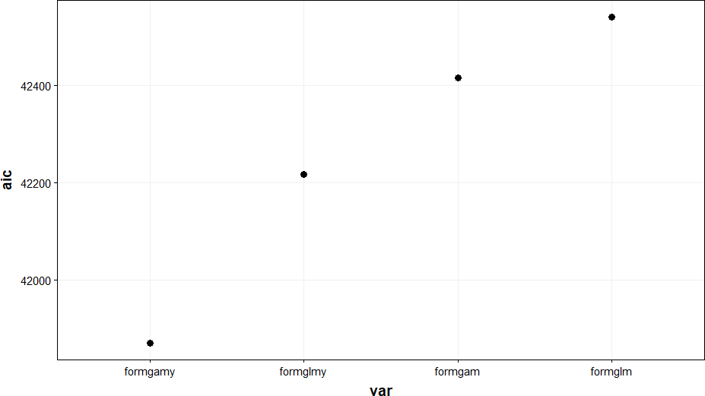
Figure 12: AIC Comparison — GLM and GAM Models with Spatial and Year Smoothers
Model selection rationale
Four models compared:
formglm GLM lat×lon
formgam GAM s(lat,lon)
formglmy GLM lat×lon×year
formgamy GAM s(lat,lon|year) ← lowest AIC
formgamy rejected because:
year effect becomes uninterpretable when
interacted with the spatial smoother —
yet year is the essential model output.
Selected:
GAM with s(lat,lon) only,
consistent with 2018 SCW6 benchmark.
Final model:
Catch ~ offset(log(effort))
+ year + vessel + month
+ s(lat,lon) + ELE
Figure 12: formgamy (GAM lat×lon×year) has lowest AIC but year effect becomes uninterpretable
www.pelagicfish.eu

Slide 8
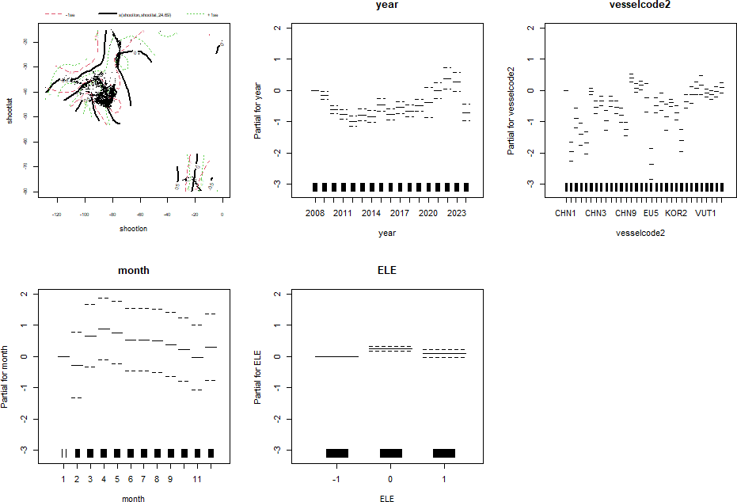
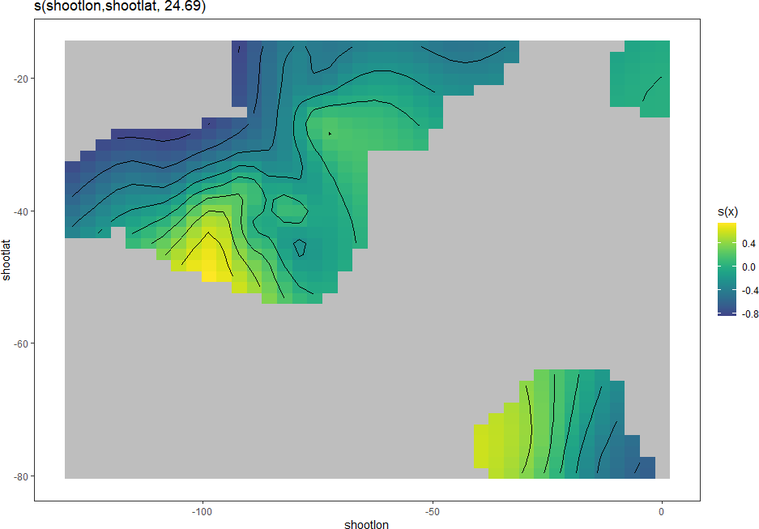
Figure 13: Final GAM — Partial Effects for Year, Vessel, Month and ELE
Figure 13: Partial effects — spatial smoother (top-left), year trend, vessel, month seasonality, ELE phase
Spatial smoother s(lat,lon), edf = 24.7 — yellow = high CPUE
www.pelagicfish.eu

Slide 9
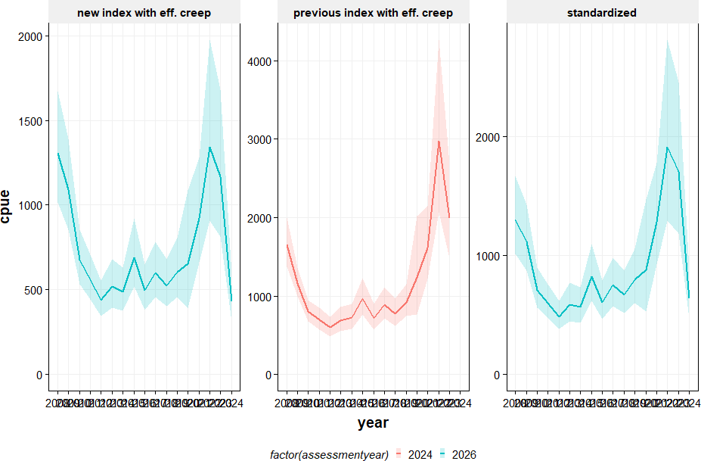
Figure 14: GAM Standardized Offshore Fleet CPUE for Jack Mackerel (Table 20)
Figure 14: Left — new index with efficiency creep; centre — previous index; right — standardized CPUE. 2026 assessment year (teal) vs 2024 (red). Peak 2022: 1,909 t/day; trough 2012: 486 t/day; 2024: 641 t/day (corrected: 428 t/day).
www.pelagicfish.eu

Slide 10
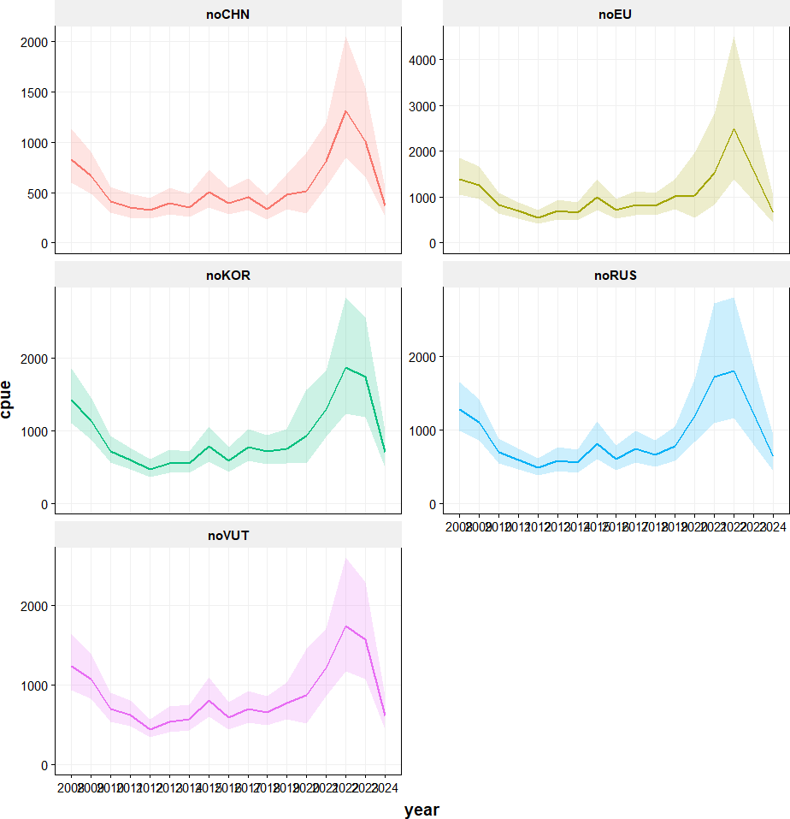
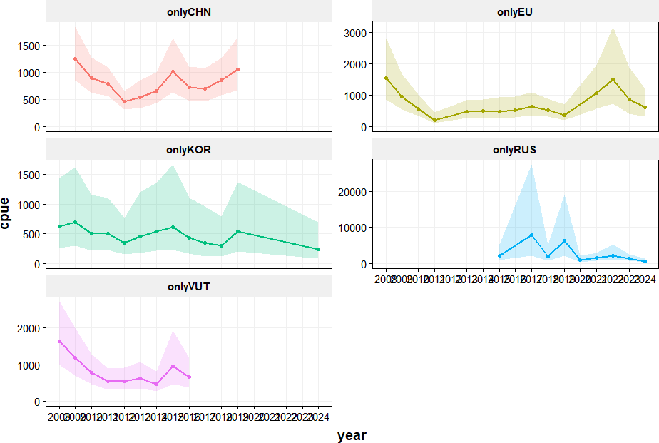
Figures 15 & 16: Robustness — Leave-One-Out and Single-Fleet Analyses
Figure 15: Leave-one-out — each CP removed in turn. Trends largely consistent; noEU increases variance post-2020.
Single-fleet analyses — overall trends comparable; onlyRUS shows wide CIs due to sparse early data.
www.pelagicfish.eu

Slide 11
Discussion and Conclusions
1
Final model
Catch ~ offset(log(effort)) + year + vessel + month + s(lat,lon) + ELE | All terms p < 2×10⁻¹⁶
2
CPUE time series starts in 2008
First year with haul-by-haul data. Recommendation: extend back before 2008 to include higher-abundance periods.
3
El Niño (ELE) is the only significant climate variable
χ² = 36.5, p = 1.18×10⁻⁸. SST anomaly is secondary; Humboldt Current Index not significant.
4
2022 peak followed by a sharp 2024 decline
Standardized CPUE: 1,909 t/day in 2022 → 641 t/day in 2024 (efficiency-corrected: 428 t/day). Warrants close attention in the 2025 stock assessment.
5
Index is robust to fleet composition
Leave-one-out analysis: trends consistent across all CP combinations. Removing EU data increases variance post-2020 as EU is now the dominant fleet.
6
Single-fleet analysis confirms robustness
Each fleet alone generates comparable trend over time, validating the combined standardized index.
www.pelagicfish.eu

